Slide 1
Box-Muller Method
Abby Lavoie
Dec. 6, 2022

Slide 2

Agenda
Motivation
Introduction
Review
Explanation
Application

Slide 3
Motivation
Generate normally distributed random variable(s)
What method(s) have we learned/used that can generate RVs from a normal distribution?
Are there any that can produce more than 1 normally distributed RV at a time?

Slide 4
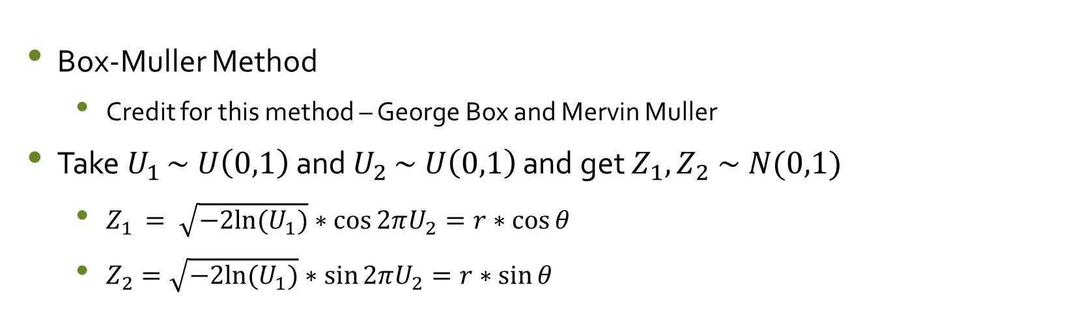
Introduction
Box-Muller Method
Credit for this method – George Box and Mervin Muller
Take $U_{1 }\sim U\left(0,1\right)$ and $U_{2 }\sim U\left(0,1\right)$ and get $Z_{1}, Z_{2} \sim N(0,1)$
$Z_{1 }= \sqrt{−2ln⁡(U_{1})}∗\cos{2πU_{2}}=r∗\cos{θ}$
$Z_{2}=\sqrt{−2ln⁡(U_{1})}∗\sin{2πU_{2}}=r∗\sin{θ}$

Slide 5
Review: Polar Coordinate System
What do you remember about converting from Cartesian coordinates to polar coordinates?

Slide 6
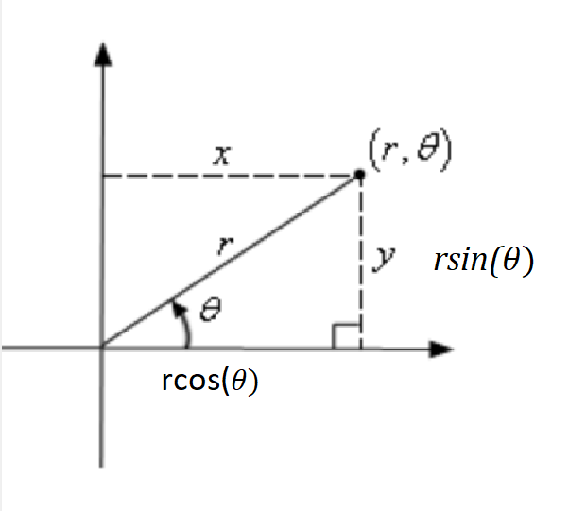
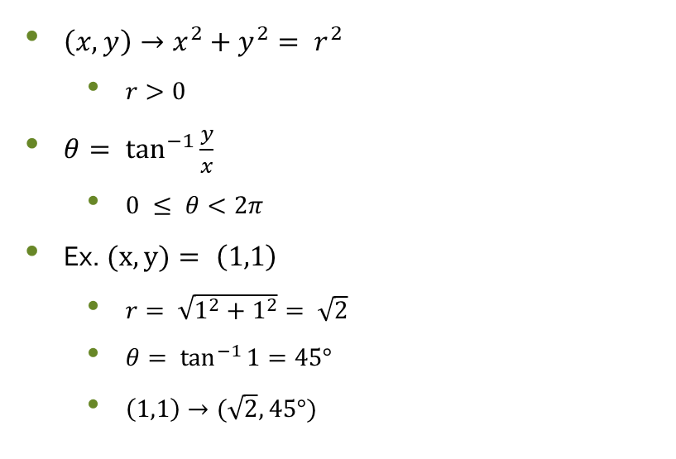
Review: Polar Coordinate System ctd.
$\left(x,y\right)→x^{2}+y^{2}= r^{2}$
$r>0$
$θ= \tan^{−1}{\frac{y}{x}}$
$0 ≤ θ<2π$
Ex. $(x,y)= \left(1,1\right)$
$r= \sqrt{1^{2}+1^{2}}= \sqrt{2}$
$θ= \tan^{−1}{1}=45°$
$\left(1,1\right)→(\sqrt{2}, 45°)$

Slide 7
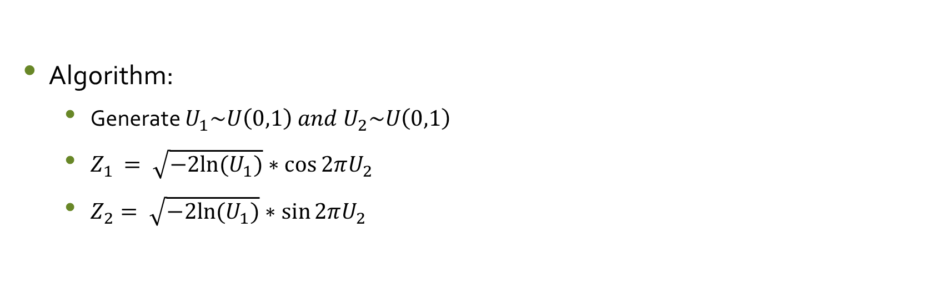
Box-Muller Method
Algorithm:
Generate $U_{1}\sim U\left(0,1\right) and U_{2}\sim U\left(0,1\right)$
$Z_{1 }= \sqrt{−2ln⁡(U_{1})}∗\cos{2πU_{2}}$
$Z_{2}= \sqrt{−2ln⁡(U_{1})}∗\sin{2πU_{2}}$

Slide 8
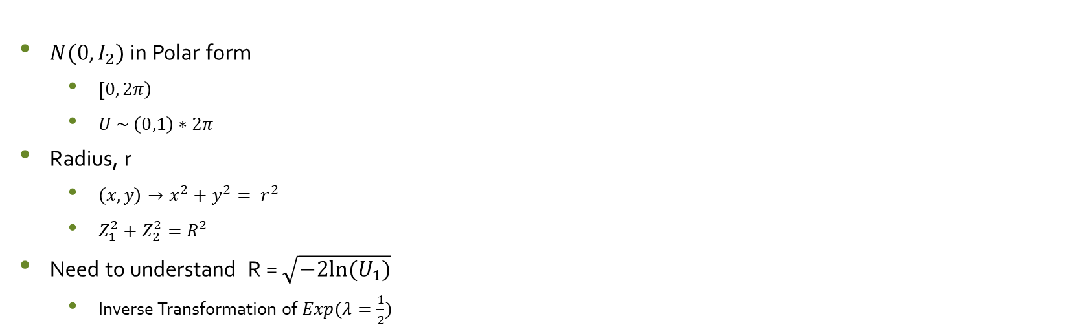
Intuitive Approach: Cartesian to Polar
$N(0, I_{2})$ in Polar form
$\left[0, 2π\right)$
$U \sim \left(0,1\right)∗2π$
Radius, r
$\left(x,y\right)→x^{2}+y^{2}= r^{2}$
$Z_{1}^{2}+Z_{2}^{2}=R^{2}$
Need to understand R = $\sqrt{−2ln⁡(U_{1})}$
Inverse Transformation of $Exp(λ=\frac{1}{2})$

Slide 9
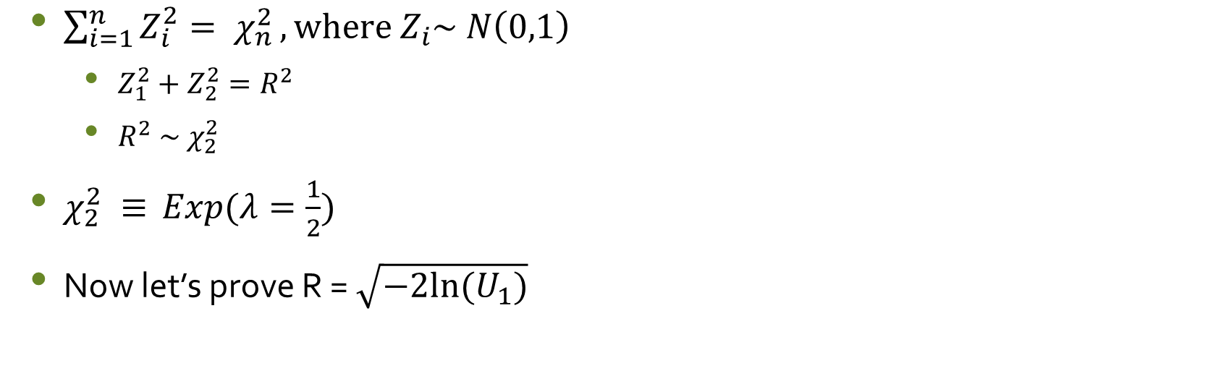
Exponential Connection
$\sum_{i=1}^{n}{Z_{i}^{2}= χ_{n}^{2}}, where Z_{i}\sim N\left(0,1\right)$
$Z_{1}^{2}+Z_{2}^{2}=R^{2}$
$R^{2} \sim χ_{2}^{2}$
$χ_{2}^{2} ≡$ $Exp(λ=\frac{1}{2})$
Now let’s prove R = $\sqrt{−2ln⁡(U_{1})}$

Slide 10
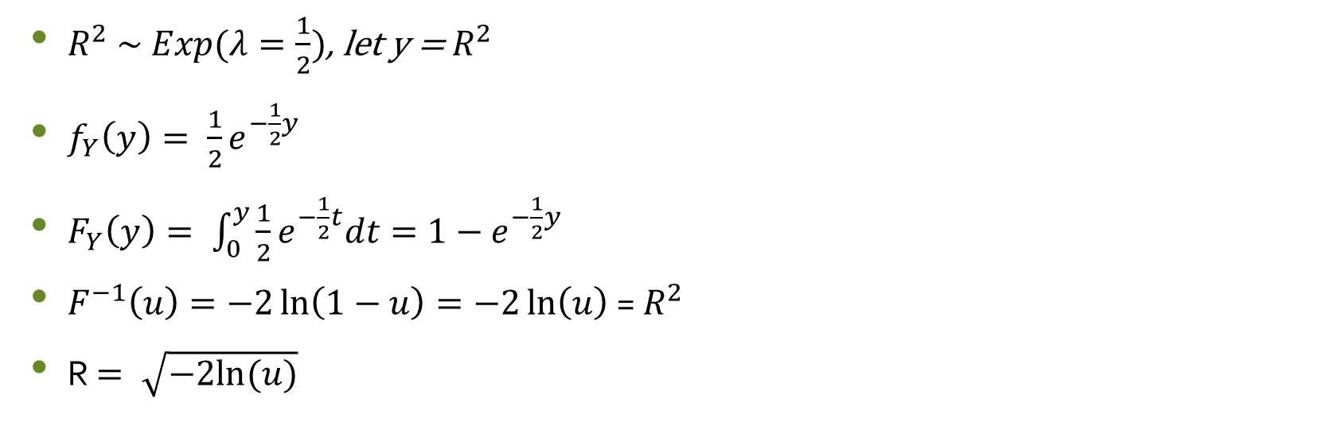

ITM: $Exp(λ=\frac{1}{2})$
$R^{2} \sim Exp(λ=\frac{1}{2})$, let y = $R^{2}$
$f_{Y}\left(y\right)= \frac{1}{2}e^{−\frac{1}{2}y}$
$F_{Y}\left(y\right)= \int_{0}^{y}{\frac{1}{2}e^{−\frac{1}{2}t}dt}=1−e^{−\frac{1}{2}y}$
$F^{−1}\left(u\right)=−2\ln\left(1−u\right)=−2\ln\left(u\right)$ = $R^{2}$
R $= \sqrt{−2ln⁡(u)}$

Slide 11
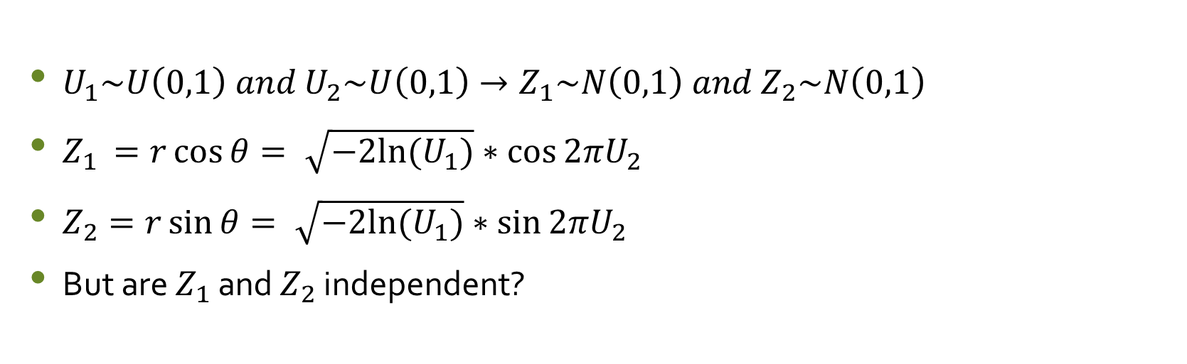
Summary
$U_{1}\sim U\left(0,1\right) and U_{2}\sim U\left(0,1\right)→Z_{1}\sim N\left(0,1\right) and{ Z}_{2}\sim N\left(0,1\right)$
$Z_{1 }=r\cos{θ}= \sqrt{−2ln⁡(U_{1})}∗\cos{2πU_{2}}$
$Z_{2}=r\sin{θ}= \sqrt{−2ln⁡(U_{1})}∗\sin{2πU_{2}}$
But are $Z_{1}$ and $Z_{2}$ independent?

Slide 12
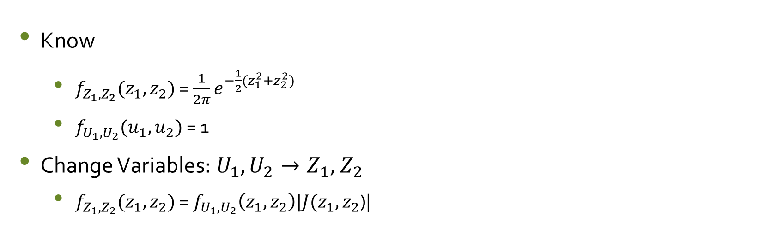
Proof of Independence
Know
$f_{Z_{1},Z_{2}}(z_{1},z_{2})$ = $\frac{1}{2π}e^{−\frac{1}{2}(z_{1}^{2}+z_{2}^{2})}$
$f_{U_{1},U_{2}}(u_{1},u_{2})$ = 1
Change Variables:$U_{1},U_{2}→Z_{1},{ Z}_{2}$
$f_{Z_{1},Z_{2}}(z_{1},z_{2})$ = $f_{U_{1},U_{2}}\left(z_{1},z_{2}\right)|J(z_{1},z_{2}$)|

Slide 13
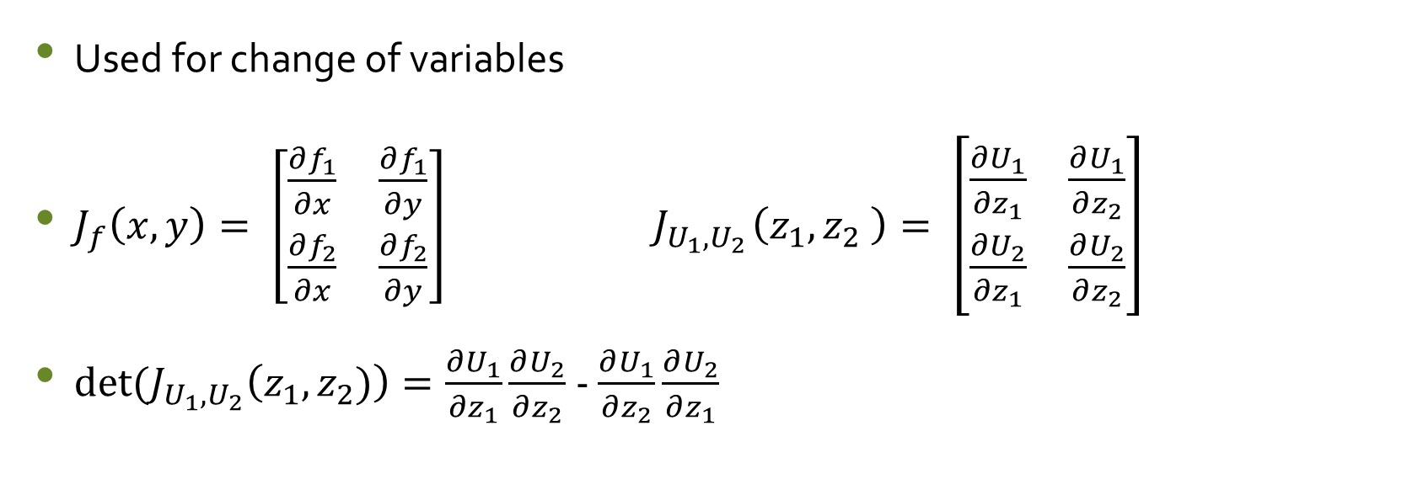
The Jacobian
Used for change of variables
$J_{f}\left(x,y\right)= \left[\begin{matrix}\frac{∂f_{1}}{∂x} & \frac{∂f_{1}}{∂y} \\ \frac{∂f_{2}}{∂x} & \frac{∂f_{2}}{∂y}\end{matrix}\right] { J}_{U_{1},U_{2}}\left(z_{1},z_{2} \right)= \left[\begin{matrix}\frac{∂U_{1}}{∂z_{1}} & \frac{∂U_{1}}{∂z_{2}} \\ \frac{∂U_{2}}{∂z_{1}} & \frac{∂U_{2}}{∂z_{2}}\end{matrix}\right]$
$det⁡(J_{U_{1},U_{2}}\left(z_{1},z_{2})\right)=\frac{∂U_{1}}{∂z_{1}}\frac{∂U_{2}}{∂z_{2}}$- $\frac{∂U_{1}}{∂z_{2}}\frac{∂U_{2}}{∂z_{1}}$

Slide 14
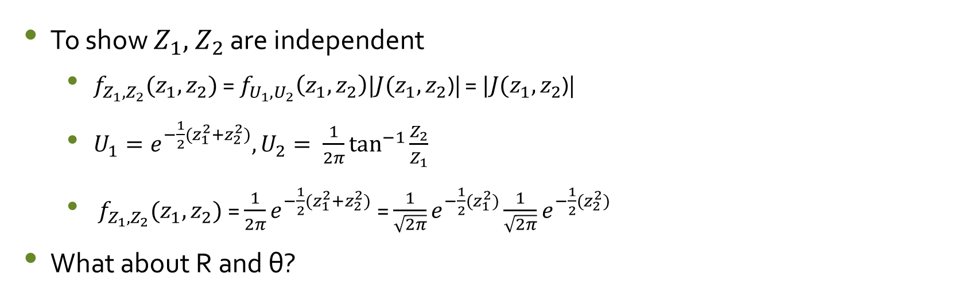
Proof of Independence, ctd.
To show $Z_{1},{ Z}_{2}$ are independent
$f_{Z_{1},Z_{2}}(z_{1},z_{2})$ = $f_{U_{1},U_{2}}\left(z_{1},z_{2}\right)|J(z_{1},z_{2}$)| = $|J(z_{1},z_{2}$)|
$U_{1}=e^{−\frac{1}{2}(z_{1}^{2}+z_{2}^{2})}, U_{2}= \frac{1}{2π}\tan^{−1}{\frac{Z_{2}}{Z_{1}}}$
$f_{Z_{1},Z_{2}}(z_{1},z_{2})$ = $\frac{1}{2π}e^{−\frac{1}{2}(z_{1}^{2}+z_{2}^{2})}$ = $\frac{1}{\sqrt{2π}}e^{−\frac{1}{2}(z_{1}^{2})}\frac{1}{\sqrt{2π}}e^{−\frac{1}{2}(z_{2}^{2})}$
What about R and θ?

Slide 15
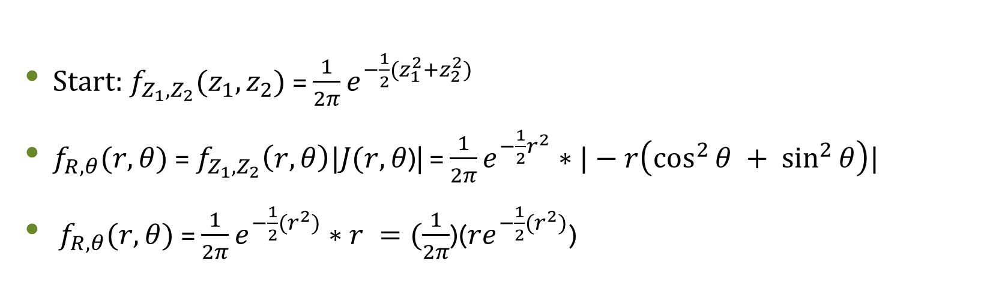
Proof of Independence, ctd.
Start: $f_{Z_{1},Z_{2}}(z_{1},z_{2})$ = $\frac{1}{2π}e^{−\frac{1}{2}(z_{1}^{2}+z_{2}^{2})}$
$f_{R, θ}(r, θ)\text{ = }f_{Z_{1},Z_{2}}\left(r, θ\right)|J(r,θ\text{)|}$ = $\frac{1}{2π}e^{−\frac{1}{2}r^{2}}∗|−r\left({\cos^{2}{θ} + sin}^{2}{θ}\right)|$
$f_{R, θ}(r, θ)$= $\frac{1}{2π}e^{−\frac{1}{2}(r^{2})}∗r =(\frac{1}{2π}$)(${re}^{−\frac{1}{2}(r^{2})}$)

Slide 16
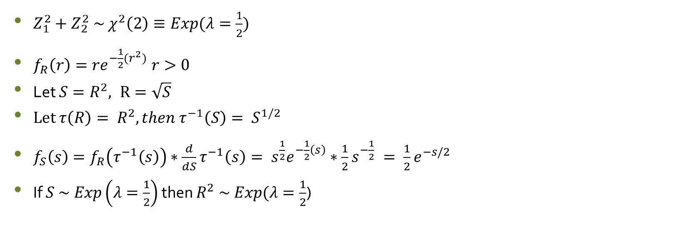

Proof: $R^{2} \sim$ Exponential
$Z_{1}^{2}+Z_{2}^{2} \sim χ^{2}\left(2\right)≡Exp(λ=\frac{1}{2})$
$f_{R}\left(r\right)={re}^{−\frac{1}{2}(r^{2})} r>0$
Let $S=R^{2}, R=\sqrt{S}$
Let $τ\left(R\right)= R^{2}, then τ^{−1}\left(S\right)= S^{1/2}$
$f_{S}\left(s\right)=f_{R}\left(τ^{−1}\left(s\right)\right)∗\frac{d}{dS}τ^{−1}\left(s\right)= s^{\frac{1}{2}}e^{−\frac{1}{2}\left(s\right)}∗\frac{1}{2}s^{−\frac{1}{2}} = \frac{1}{2}e^{−s/2}$
If $S \sim Exp\left(λ=\frac{1}{2}\right)$ then $R^{2} \sim Exp(λ=\frac{1}{2}$)

Slide 17
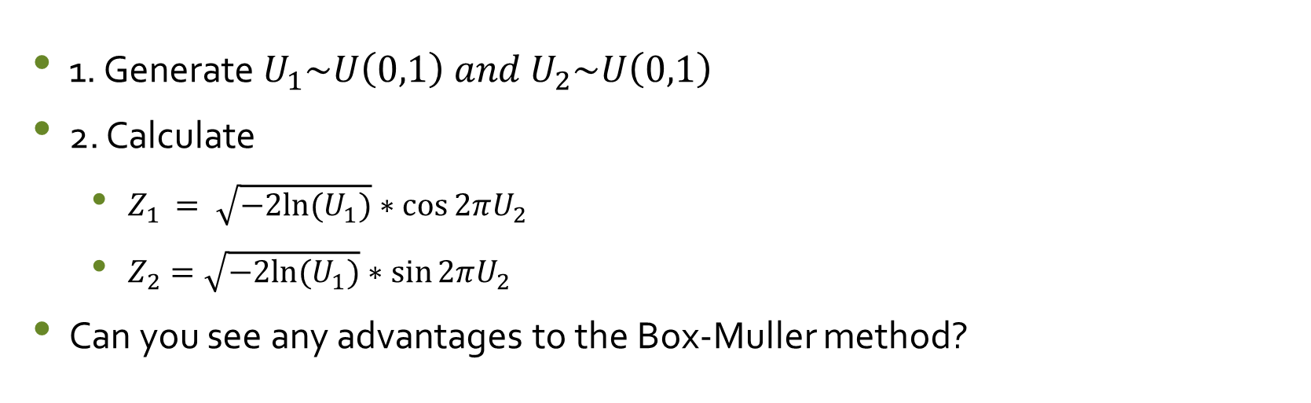
Summary
1. Generate $U_{1}\sim U\left(0,1\right) and U_{2}\sim U\left(0,1\right)$
2. Calculate
$Z_{1 }= \sqrt{−2ln⁡(U_{1})}∗\cos{2πU_{2}}$
$Z_{2}=\sqrt{−2ln⁡(U_{1})}∗\sin{2πU_{2}}$
Can you see any advantages to the Box-Muller method?

Slide 18
Advantages
Simple, short code (easy to debug)
Based on uniform sampling
Popular
Used in Python as random normal number generator (not R)
Generates normally distributed samples

Slide 19
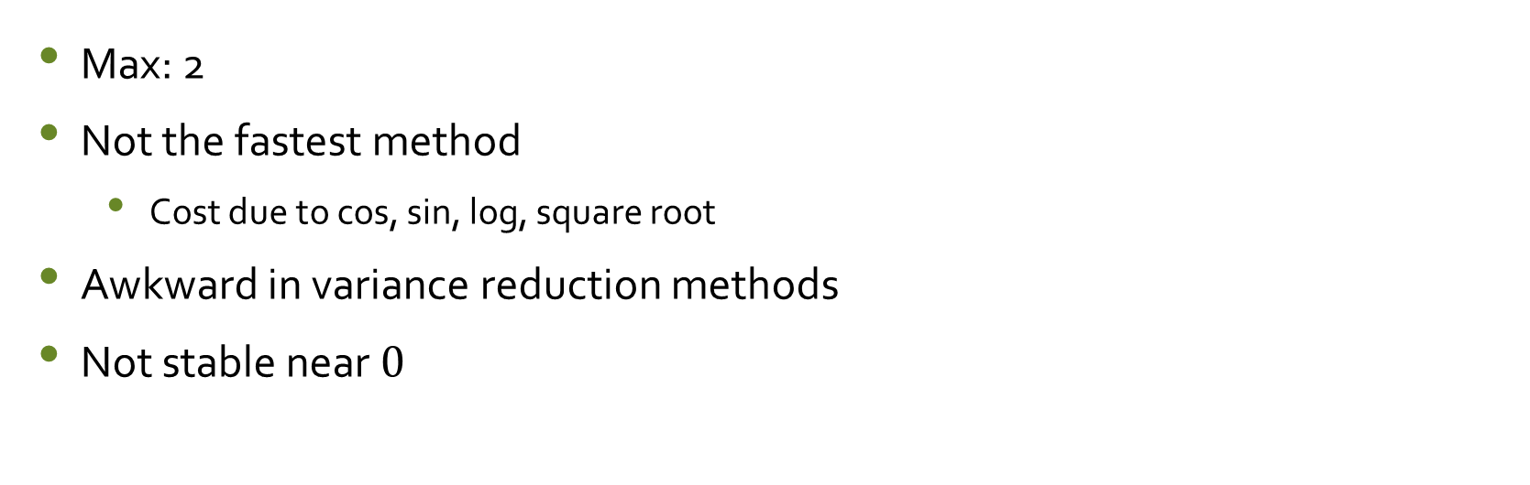
Disadvantages
Max: 2
Not the fastest method
Cost due to cos, sin, log, square root
Awkward in variance reduction methods
Not stable near $0$

Slide 20
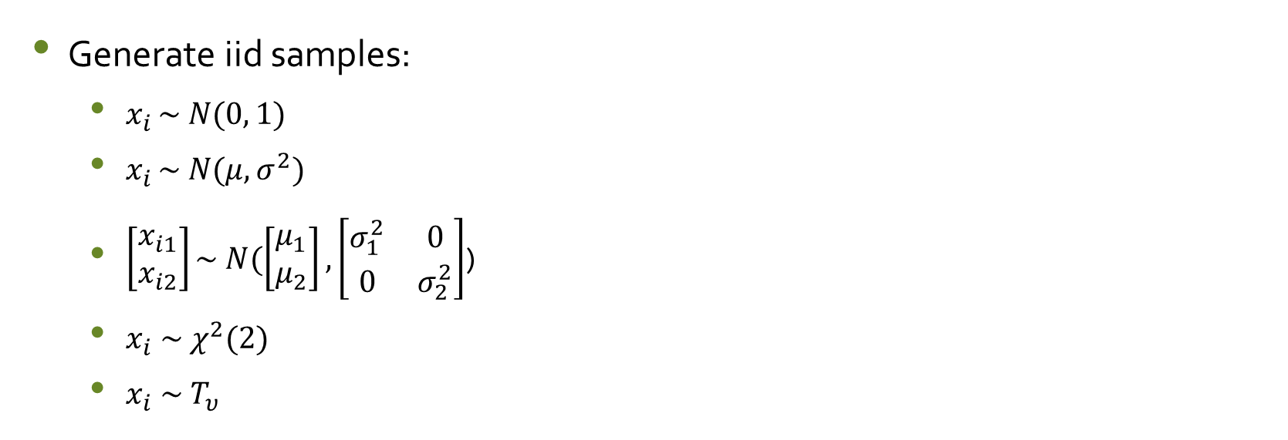
Simulation Possibilities
Generate iid samples:
$x_{i }\sim N(0, 1)$
$x_{i }\sim N(μ, σ^{2})$
$\left[\begin{matrix}x_{i1} \\ x_{i2}\end{matrix}\right]\sim N(\left[\begin{matrix}μ_{1} \\ μ_{2}\end{matrix}\right],\left[\begin{matrix}σ_{1}^{2} & 0 \\ 0 & σ_{2}^{2}\end{matrix}\right]$)
$x_{i} \sim χ^{2}(2)$
${x_{i} \sim T}_{υ}$

Slide 21
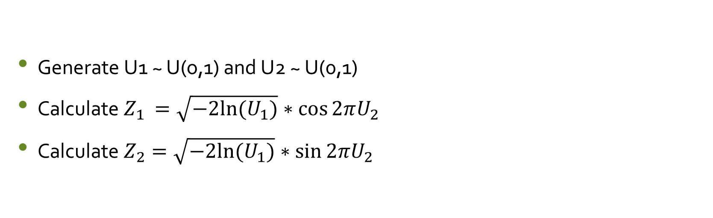
General Algorithm
Generate U1 ~ U(o,1) and U2 ~ U(0,1)
Calculate $Z_{1 }=\sqrt{−2ln⁡(U_{1})}∗\cos{2πU_{2}}$
Calculate $Z_{2}=\sqrt{−2ln⁡(U_{1})}∗\sin{2πU_{2}}$

Slide 22
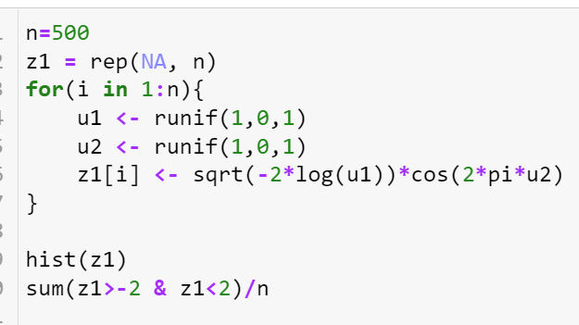
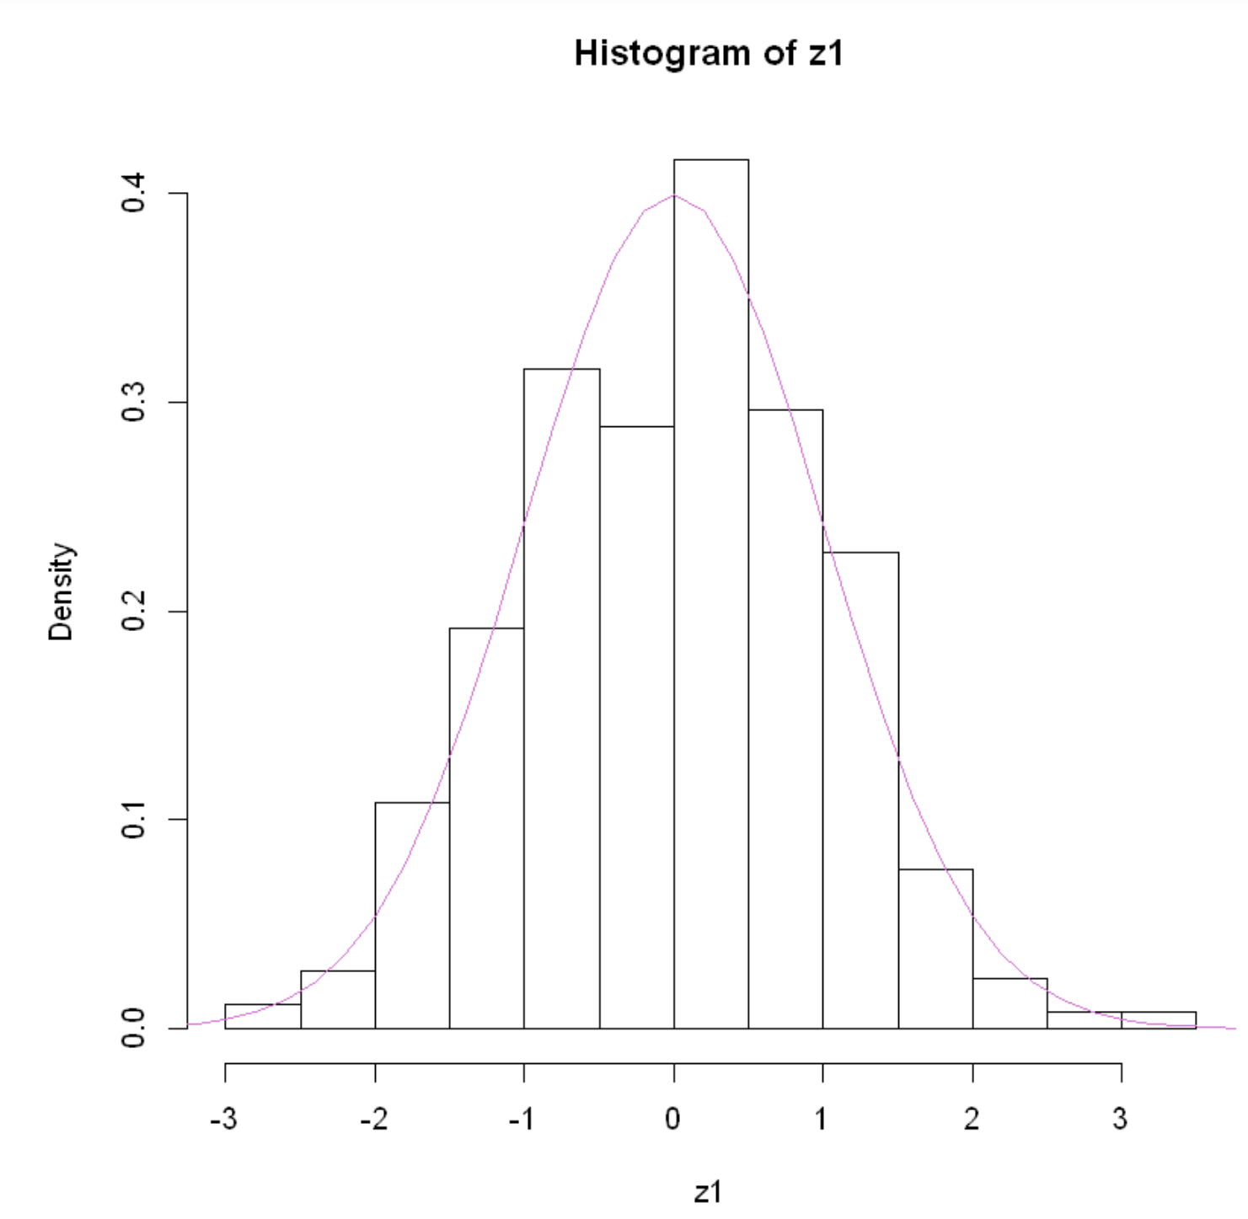
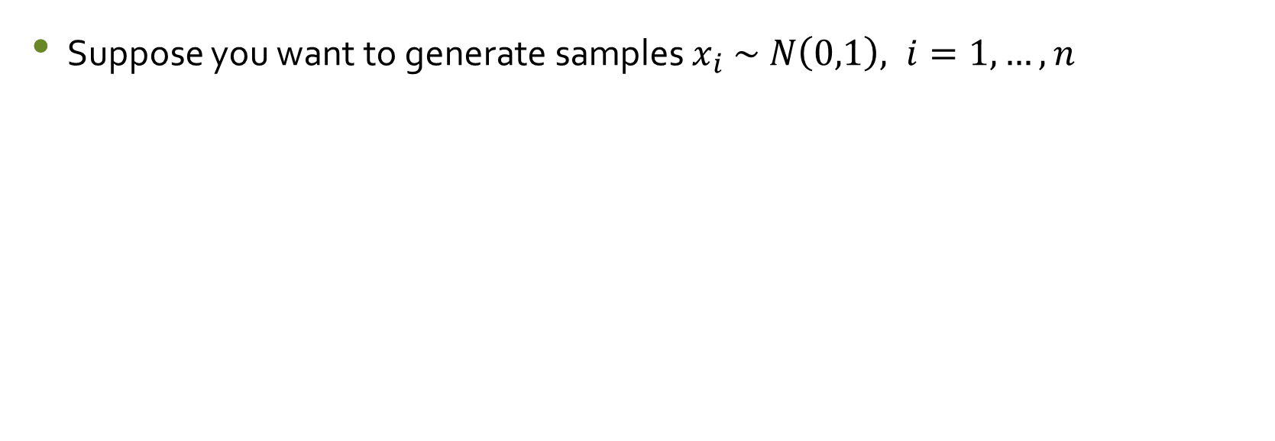
Simulation Example 1
Suppose you want to generate samples $x_{i} \sim N\left(0,1\right), i=1,…,n$

Slide 23
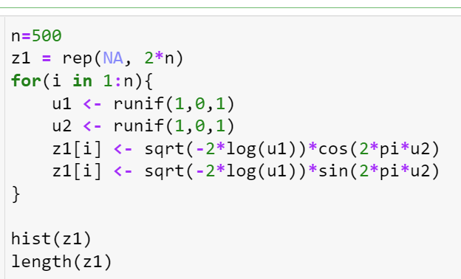
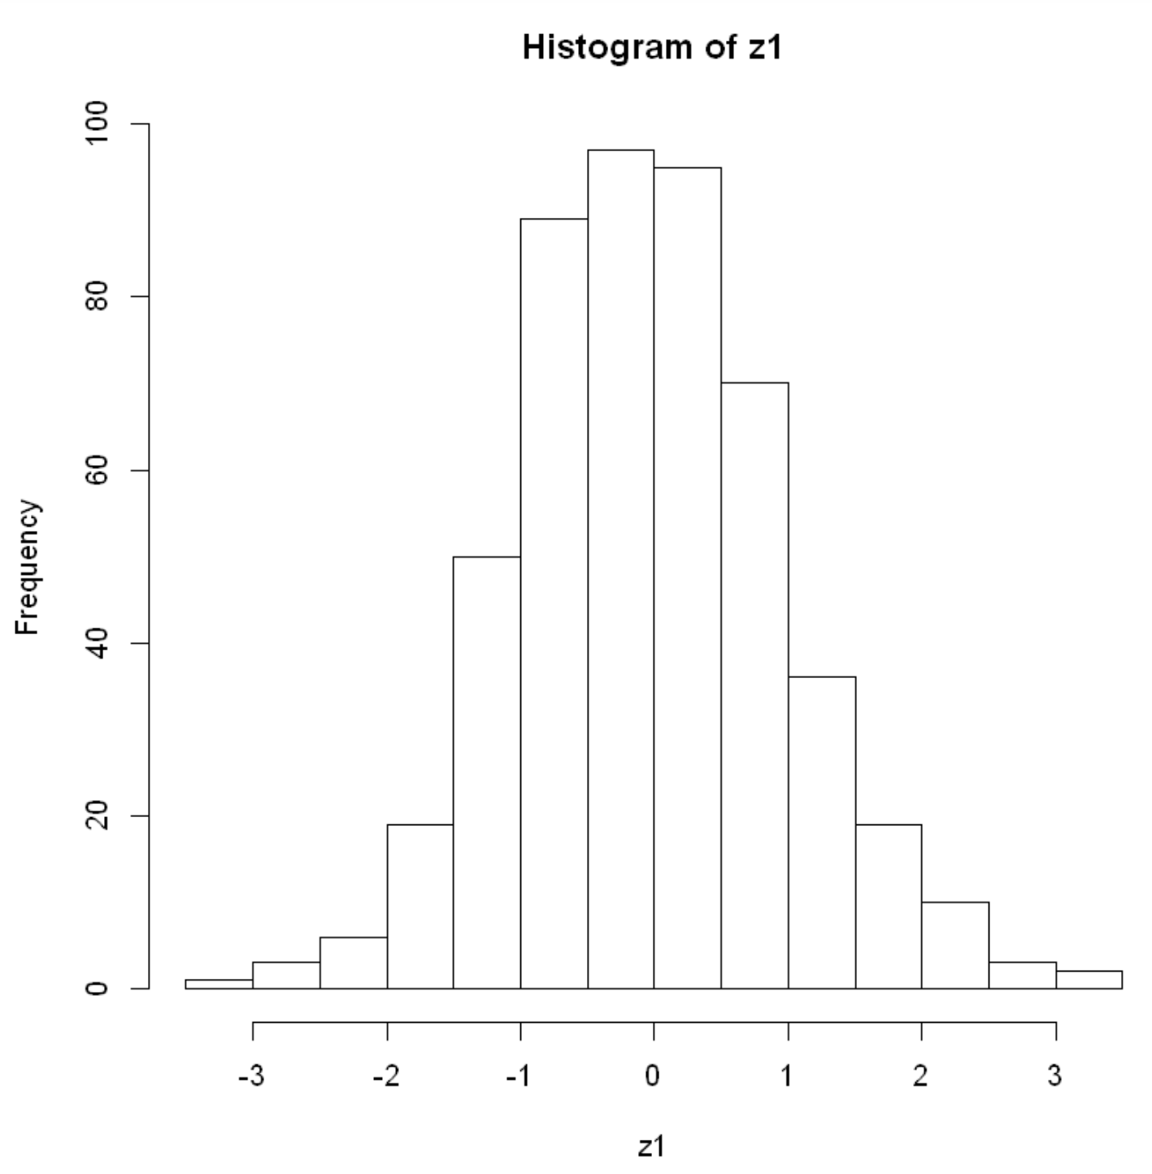
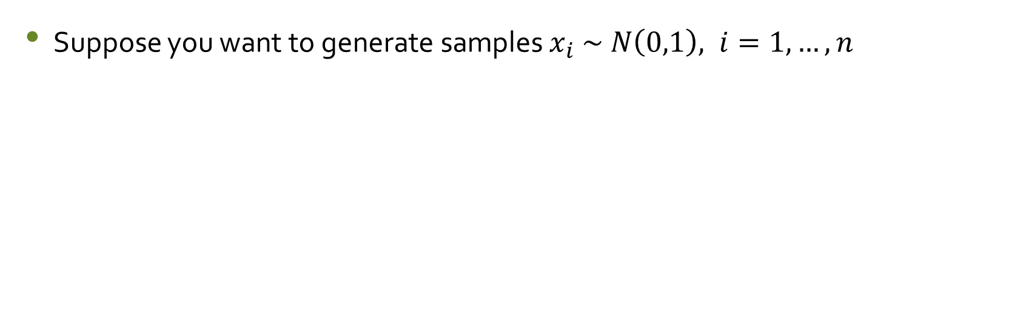
Simulation Example 2
Suppose you want to generate samples $x_{i} \sim N\left(0,1\right), i=1,…,n$

Slide 24
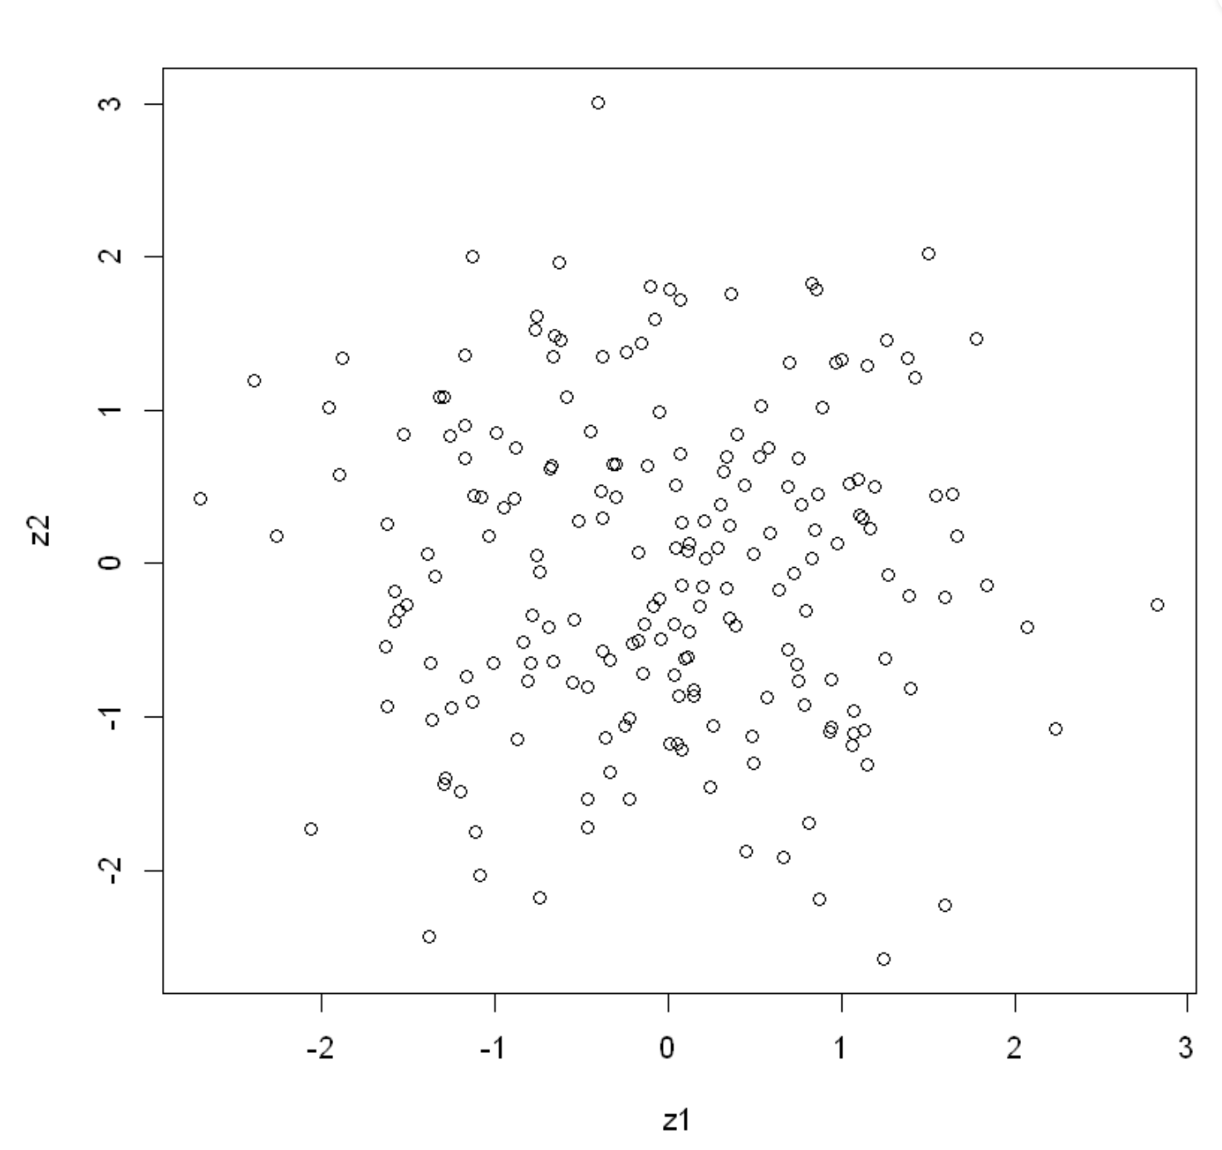
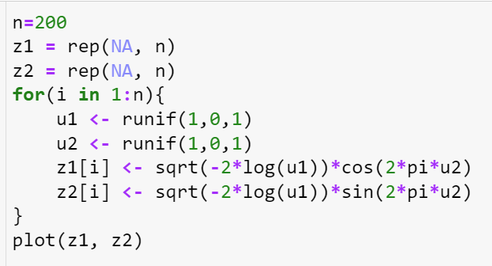
Simulation Example 3a
Review HW #4 question 2a: Generate 200 points on a 2-D sphere

Slide 25
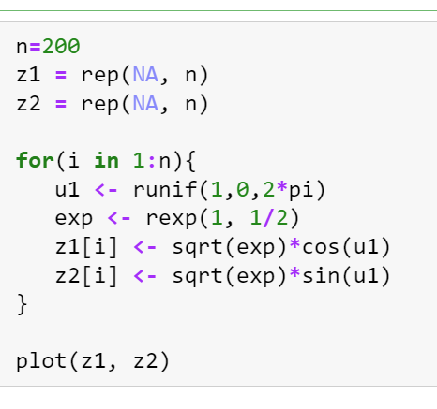
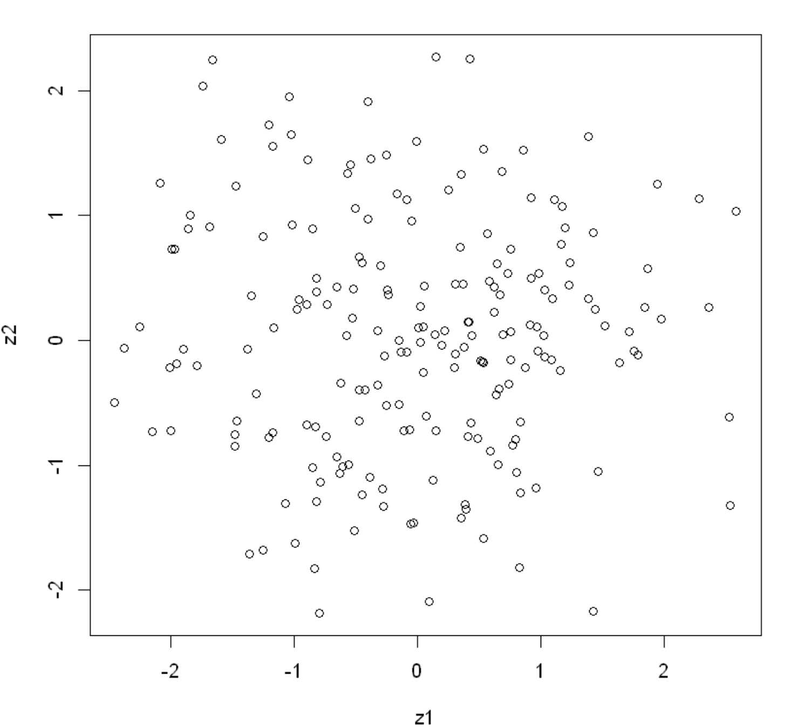
Simulation Example 3b
Generate 200 points on a 2-D sphere

Slide 26
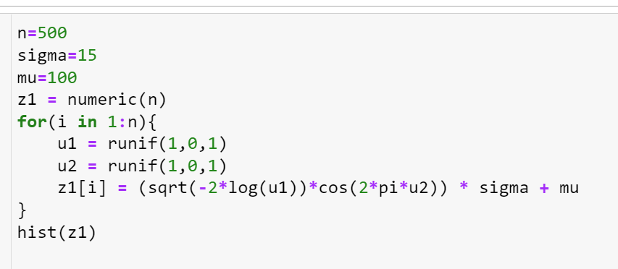
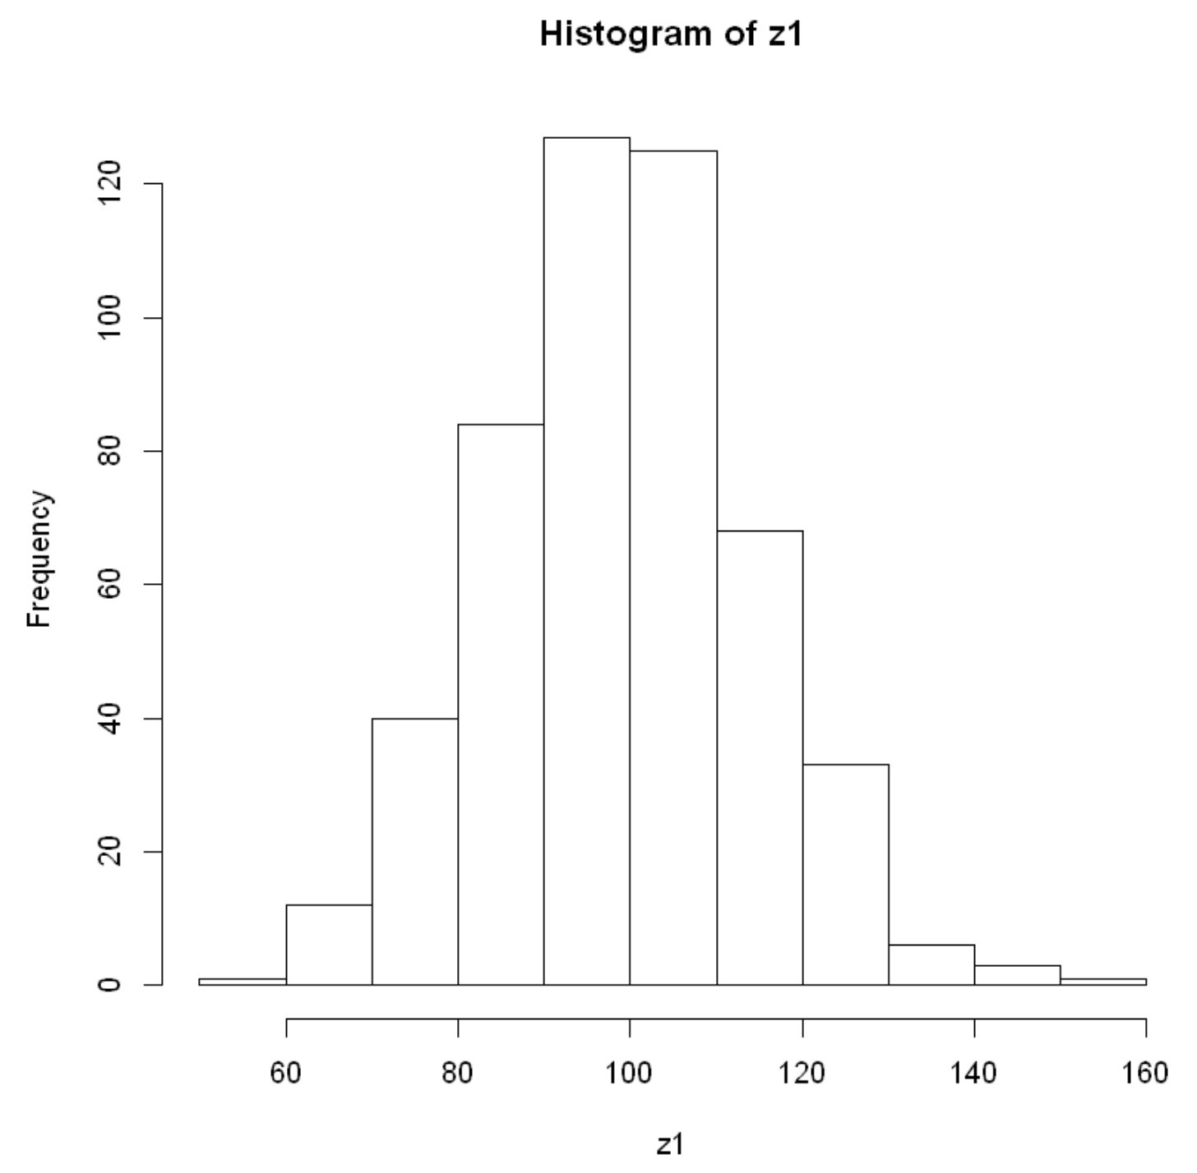

Simulation Example 4
Generate 500 samples from a $N\left(μ=100, σ=15\right)$

Slide 27
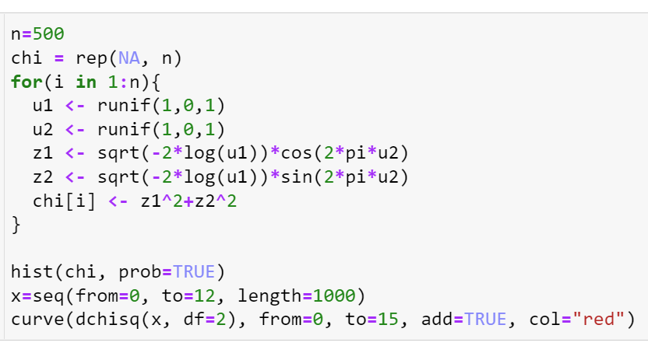
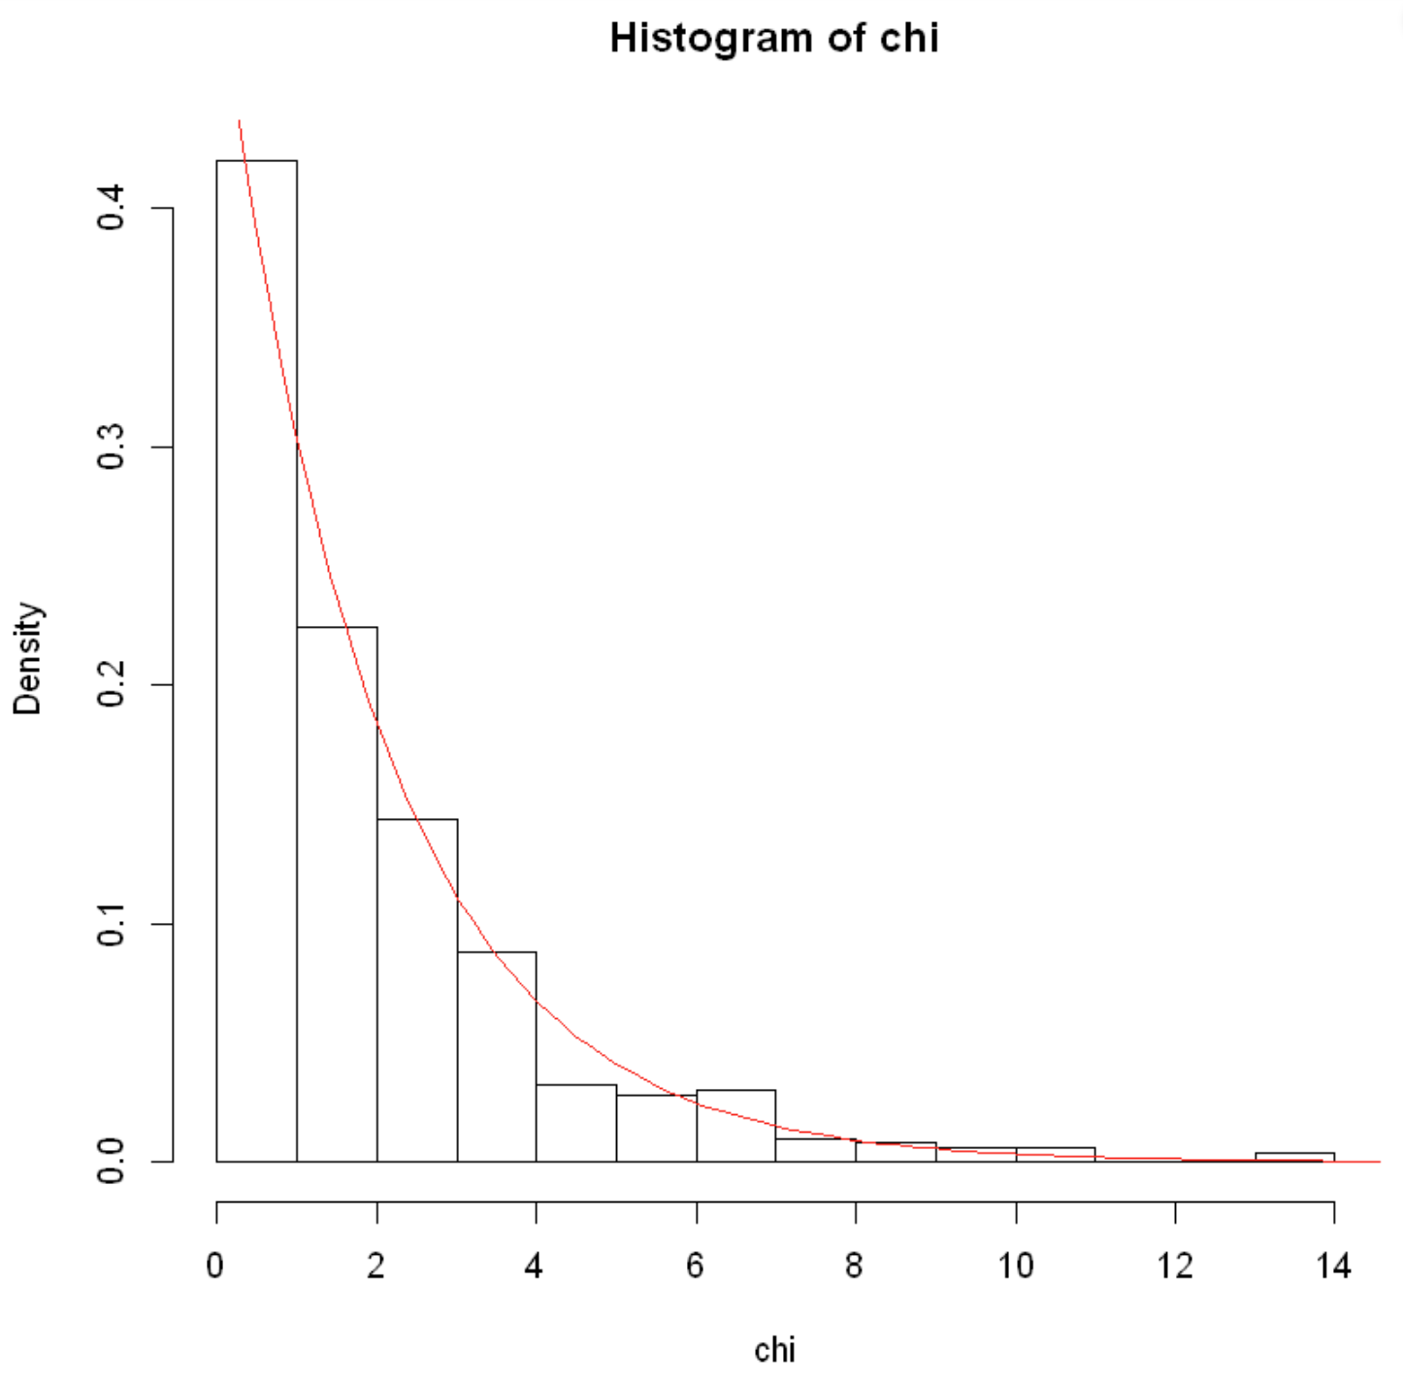
Simulation Example 5a
Generate n=500 points from Chi-Square distribution

Slide 28
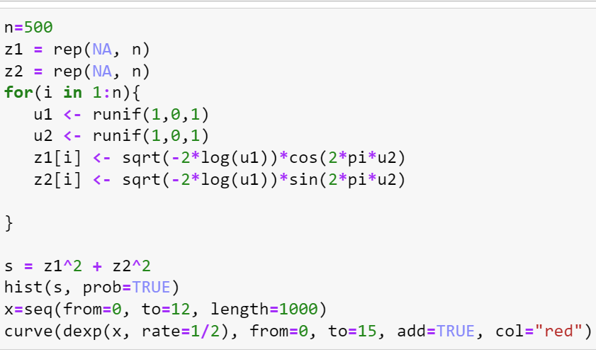
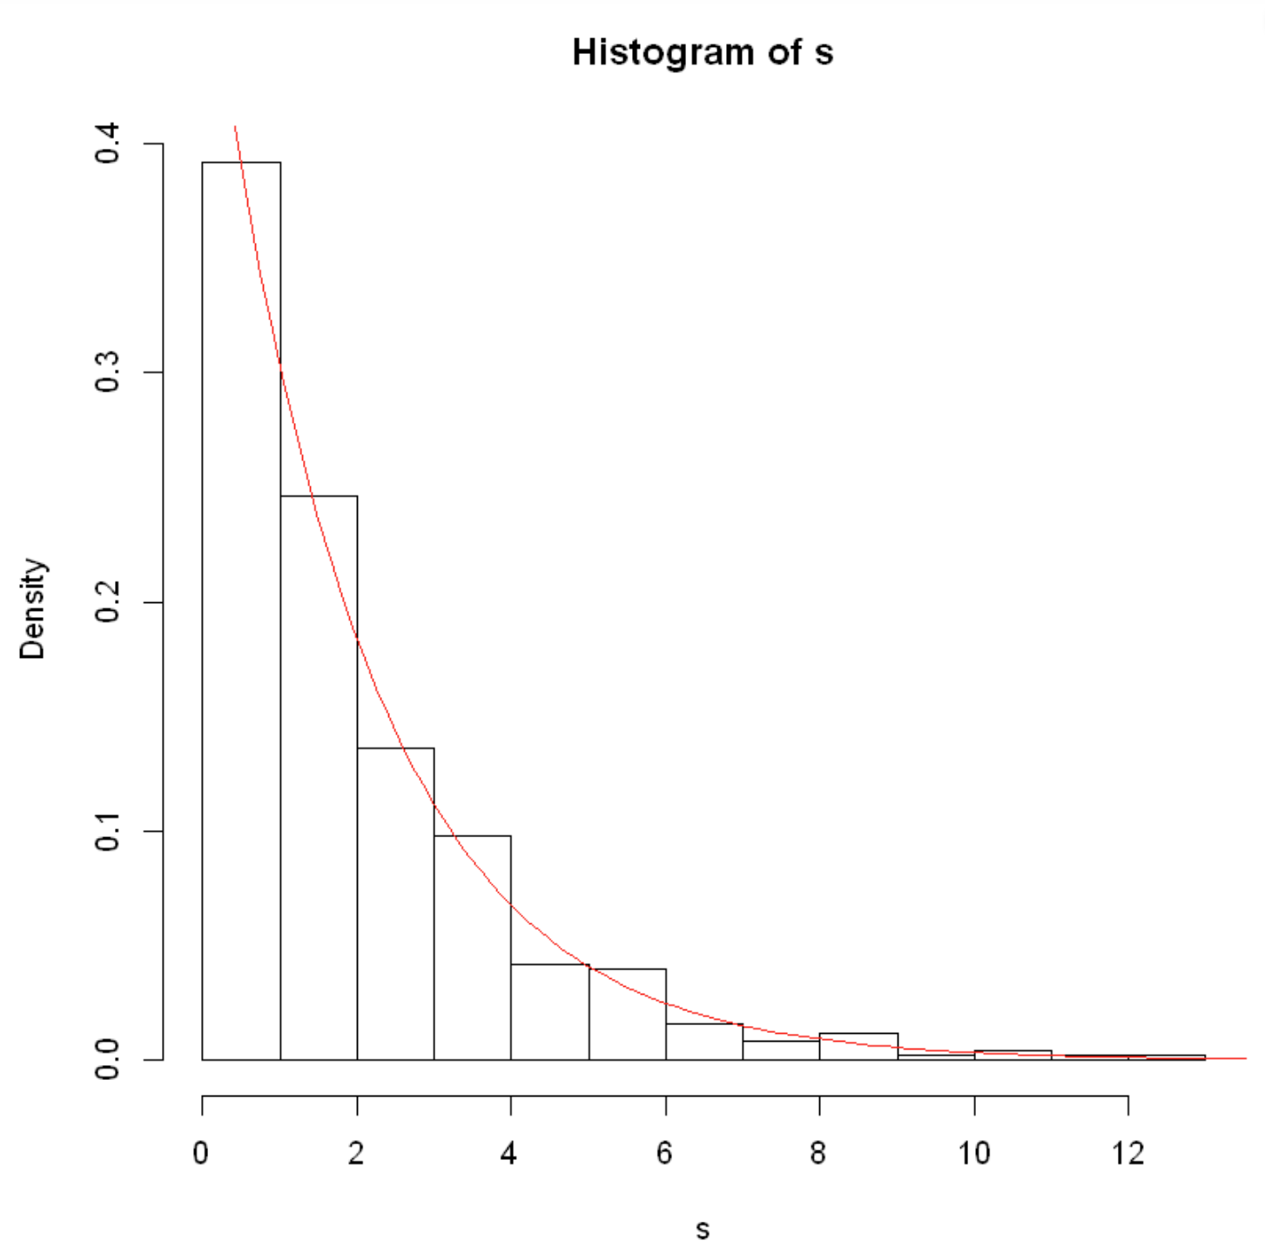

Simulation Example 5b
Generate n=500 points from Exp($\frac{1}{2}$)

Slide 29
References
Murison, M.A. (2000). “A method for Directly Generating a Gaussian Distribution with Nonunit Variance and Nonzero Mean from Uniform Random Deviates”. Found on 12/1/22 here.
Owen, Art. (2019). Monte Carlo theory, methods and examples: Non-uniform Random Numbers, pages 15-16, 35-36.
Thistleton et al. (2007). “Generalized Box-Muller Method for Generating q-Gaussian Random Deviates”, IEEE Information Theory 53(12).

